Slide 1
Widespread and distinct sequence signatures of combinatorial transcriptional regulation
Majid Kazemian
Work done in labs of
Saurabh Sinha (UIUC) and
Michael Brodksy (U. Mass Med School)
April 2013

Slide 2
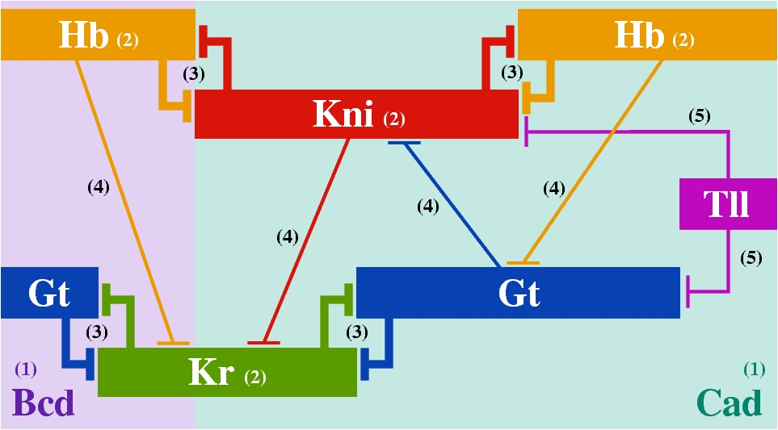
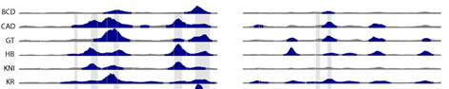
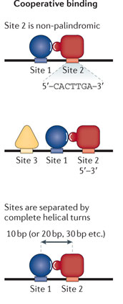
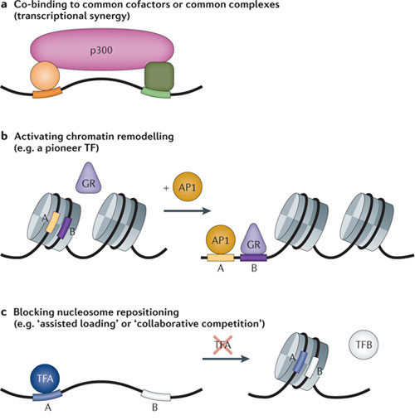
Combinatorial regulation can have footprints in DNA
FlyEx (Reinitz lab)
Co-regulation of target genes
Direct cooperative binding
MacArthur et al. Genome Biology 10, R80.
Indirect cooperative binding
Spitz & Furlong, Nature Rev Gen 2012
Notes:
Transcriptional gene regulation is mainly the process of combinatorial action among TFs. And this combinatorial action has its footprints on DNA hinting at different mechanisms such as direct cooperative bindings or indirect binding

Slide 3
Goal: search for footprints of combinatorial regulation
Global search for TFs binding to common targets
Search for local patterns: biases in inter-site spacing, orientation etc.

Slide 4
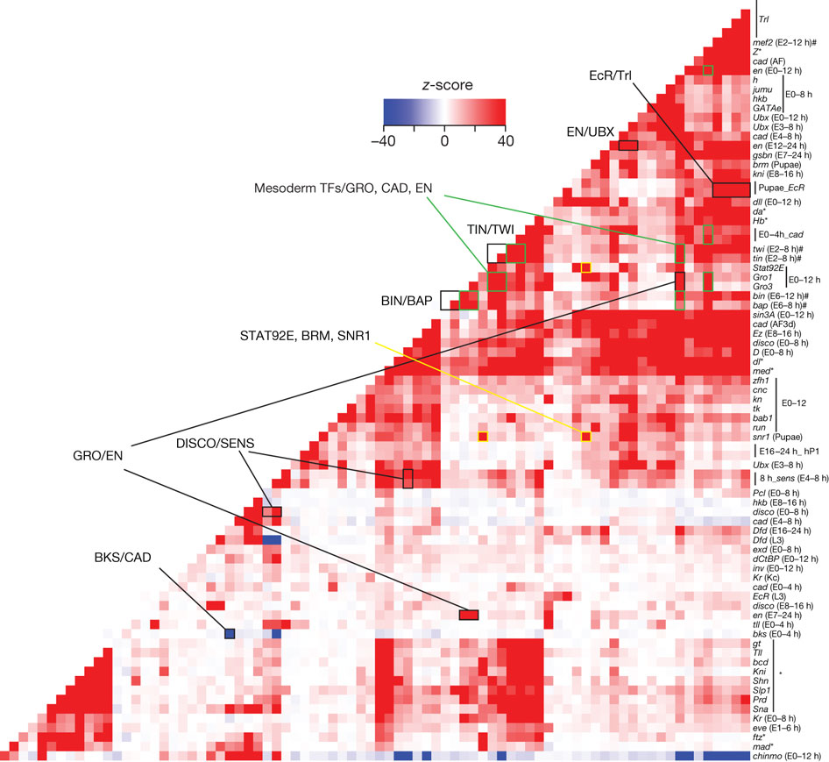
ChIP data reveals “co-binding” TF pairs
Negre et al. Nature 2011.

Slide 5
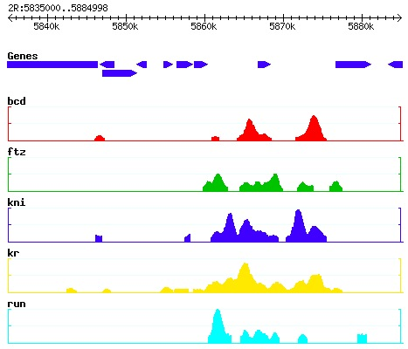
We saw the same trends on the same data
Hypergeometric test
BCD
FTZ
Universe
EVE
ChIP-SEQ

Slide 6
But TF pairs have a strong tendency to co-bind at accessible regions of DNA.

Slide 7
Conditioning on accessibility reveals TF-TF “aversion”
Hypergeometric test
DNA accessible regions
BCD
FTZ
Universe
EVE
ChIP-SEQ

Slide 8
Such global maps of TF co-binding and aversion can be a useful resource
But limited to ~50 TFs for which there is ChIP data
Build a similar but much more comprehensive map using motif scanning

Slide 9
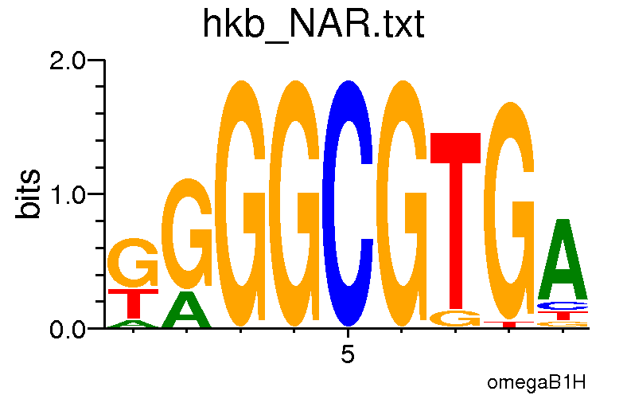
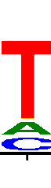
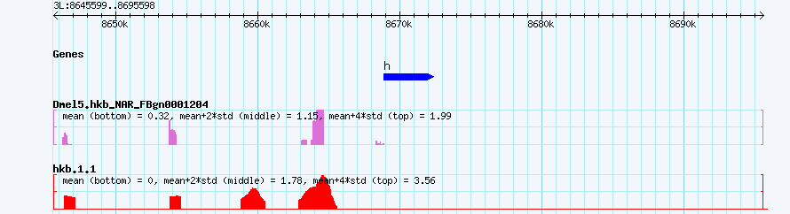
Motif scanning to predict TF bound regions (BRs)
W
HMM
W_{b}

Slide 10
Repeat TF pair association tests with predicted BRs
Hypergeometric test
Specificity: 74%
Sensitivity: 34%
DNA accessible regions
BCD
FTZ
Universe
Replace with results from Stubb peak overlaps.
EVE
ChIP-SEQ

Slide 11
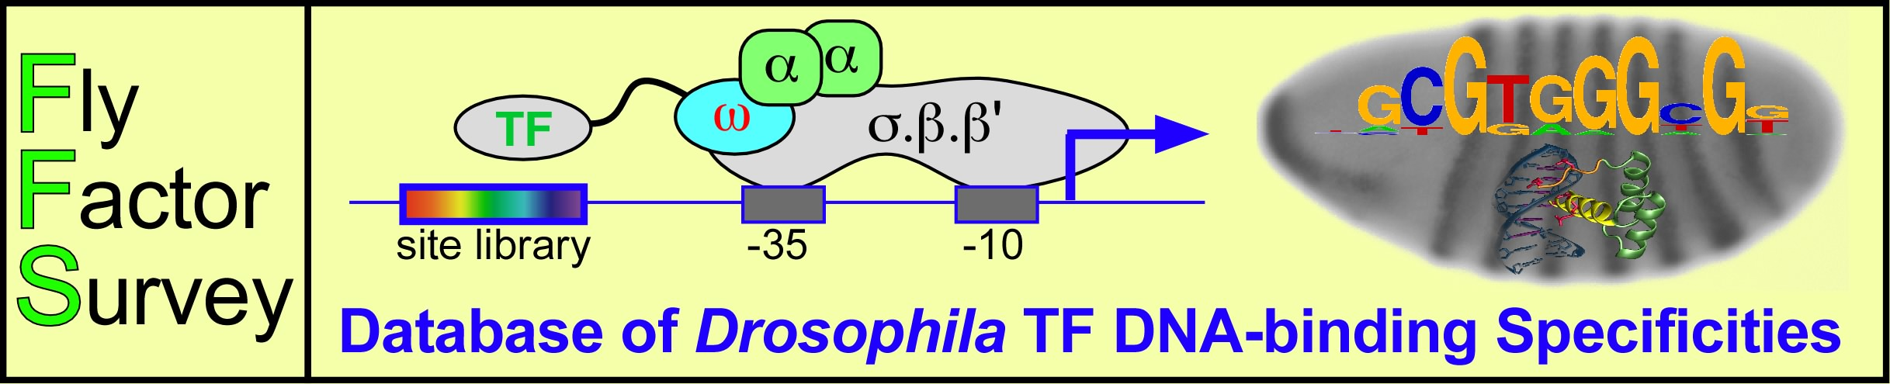


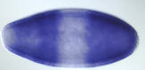
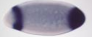
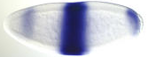
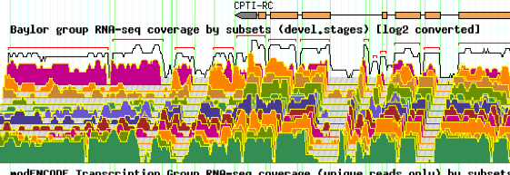
Co-binding and aversions using motif scanning
Tested > 15000 TF pairs involving > 300 TFs
34% of tested pairs show associations
Not an artifact of accessibility
Negative control: no pair significant
Aversion as common as co-binding

Slide 12
Analysis of TF pair associations
More aversion: negatively correlated with accessibility
More co-binding: positively correlated with accessibility
TFs with more co-binding associations have more aversion associations as well.

Slide 13
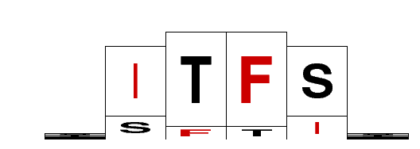
Site arrangement biases
Orientation bias
Distance bias
Orientation-specific distance bias
Statistical tool & web server for detecting such patterns

Slide 14
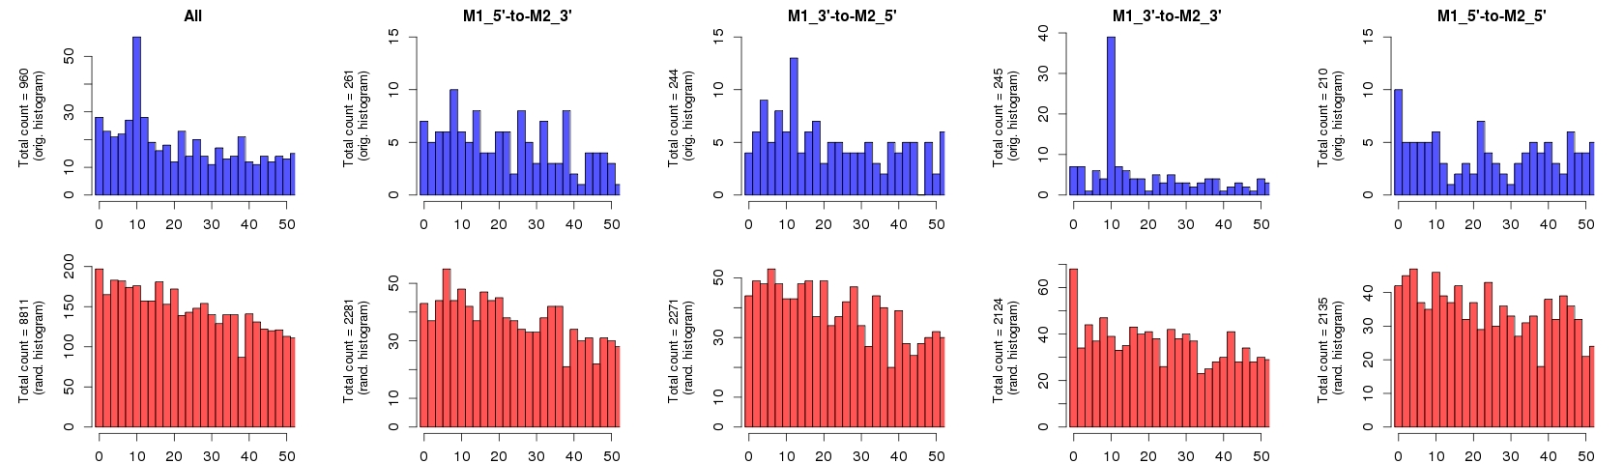
Detecting distance biases
Real data
Shuffled data
a
c
Count
Count
Distance
 | 9<d<11 | 9<d<11
Real | a | b
Shuffled | c | d
Distance
Fisher exact test

Slide 15
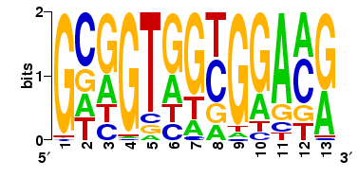
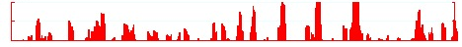

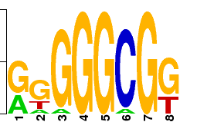
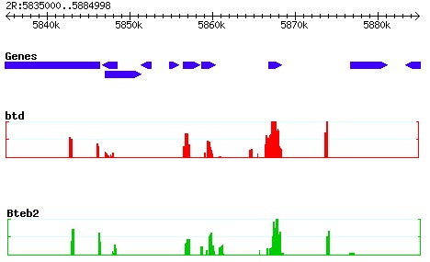
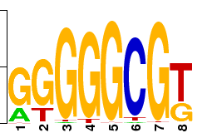
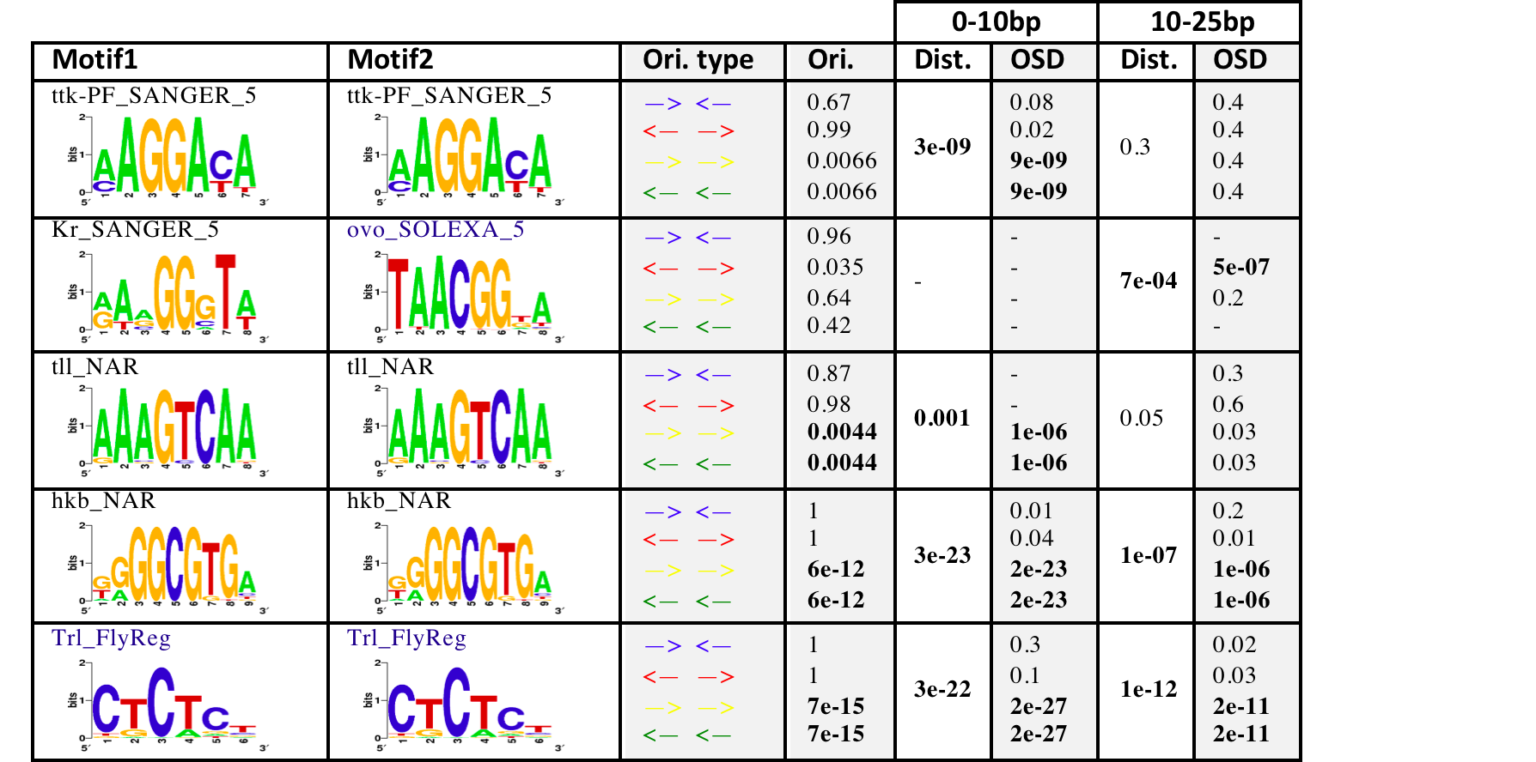
Detecting distance biases
Genome surveyor
Background
Motif
Background
Motif
Notes:
We have looked at site arrangement among a large collection of TFs in fruit fly, and observed many site arrangement biases

Slide 16
Over 700 cases of site arrangement biases predicted

Slide 17
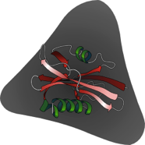

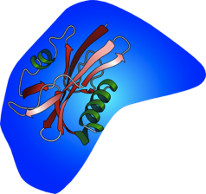
Tests of physical interactions
TF1
Luc
MBP
TF2
M
Michael Brodsky,
Hannah Pham
22/28 tests positive

Slide 18
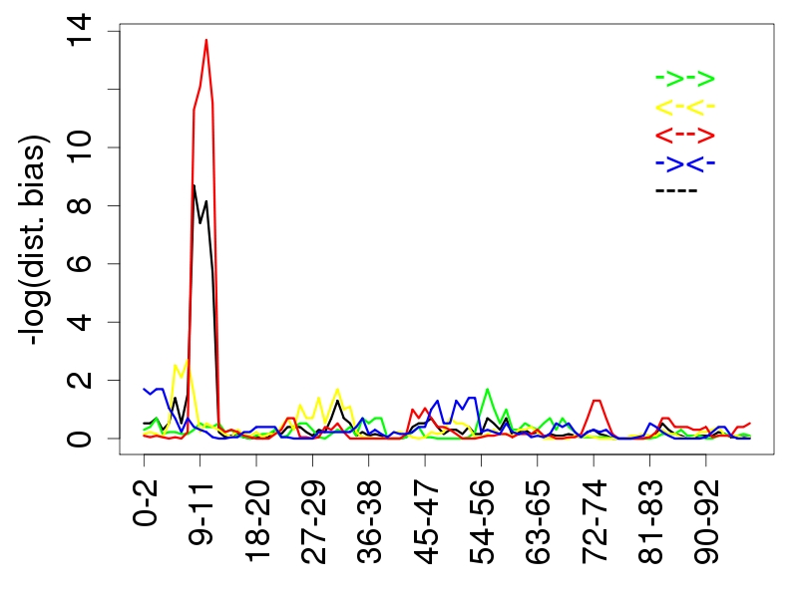
Tests of cooperative DNA binding
KR-OVO
4 homotypic and 1 heterotypic interaction tested: all positive

Slide 19


Acknowledgements
Saurabh Sinha
  Jia-yu Chen
  Charles Blatti
  Qiong Chen
  Yinan Zhang
  Hassan Samee
  Thyago Duque
Michael Brodsky
  Hannah Pham
Scot Wolfe
Marc Halfon
  Qiyun Zhu

Slide 20
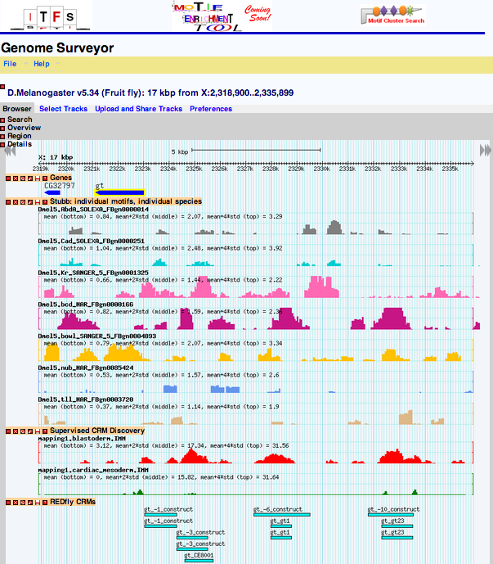
Genome Surveyor: resource for predicted BRs

